Slide 1






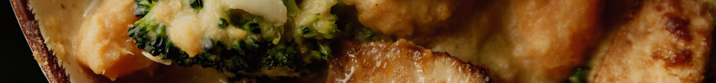
18/12/2023
Online Food Delivery System
232-JAVASL .GROUP-5

Slide 2
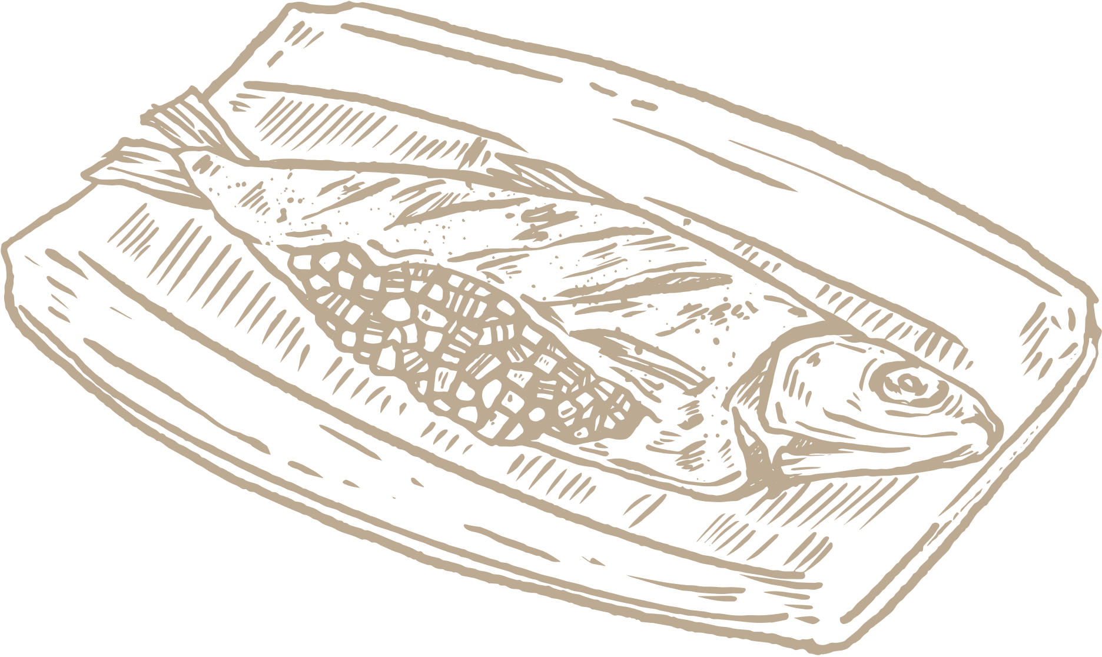

Our Best Team Members
Team Leader:
Pachala Deekshith 2576360
Team Members:
Noora Sravani 2576766
P U V N S M Janakiram Sharma 2577112
Pachala Deekshith 2576360
Paramsetty Vineela Rathanajali 2577156
Peram Swapna 2576321
Pragati Pandey 2576714
Pramod X 2577108
Pramukha A U 2577217

Slide 3

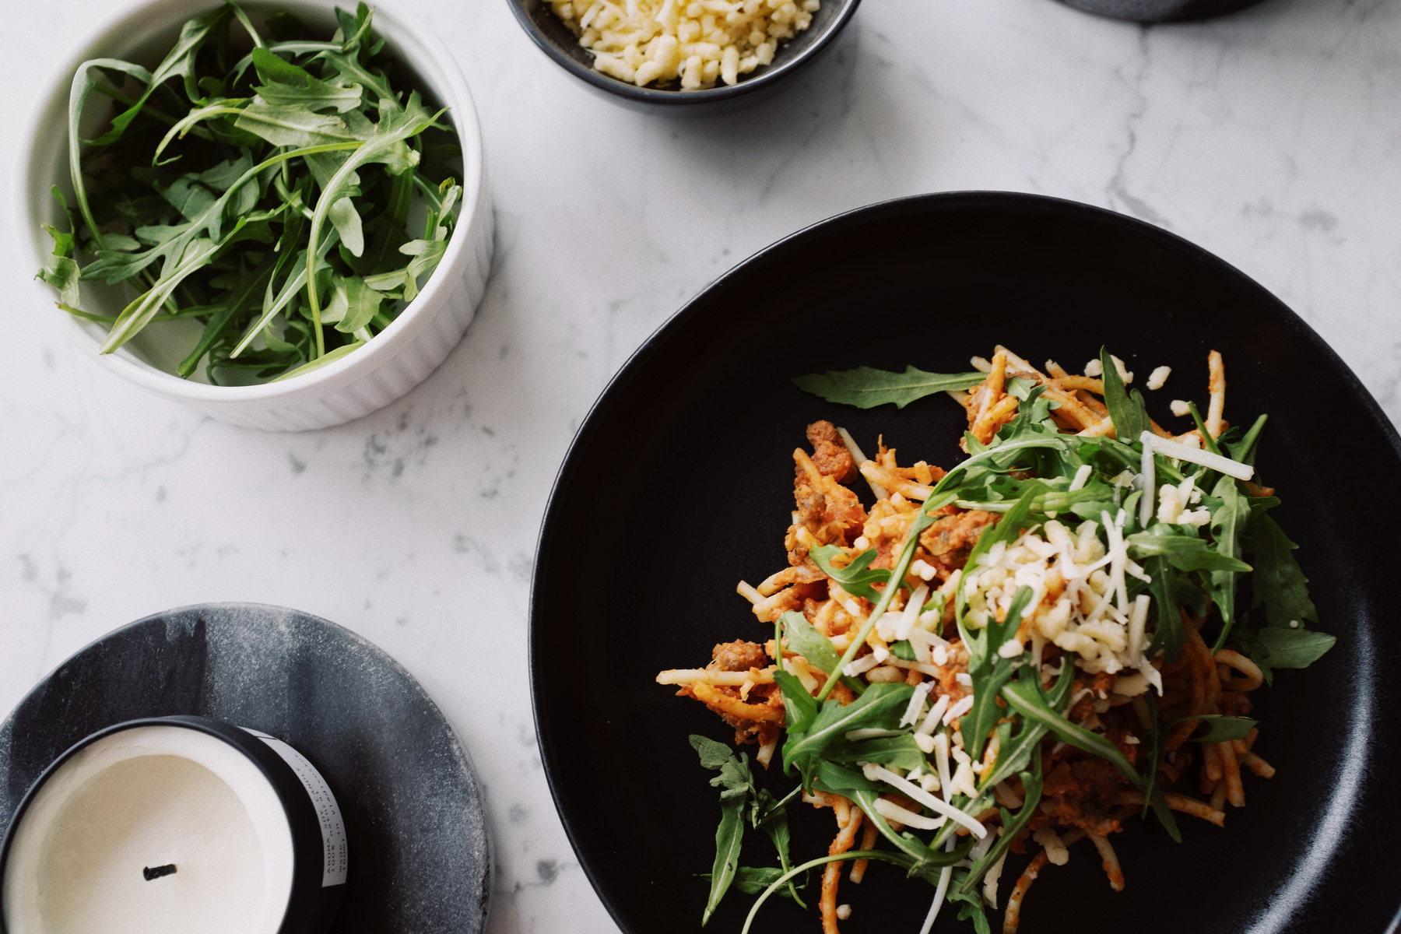
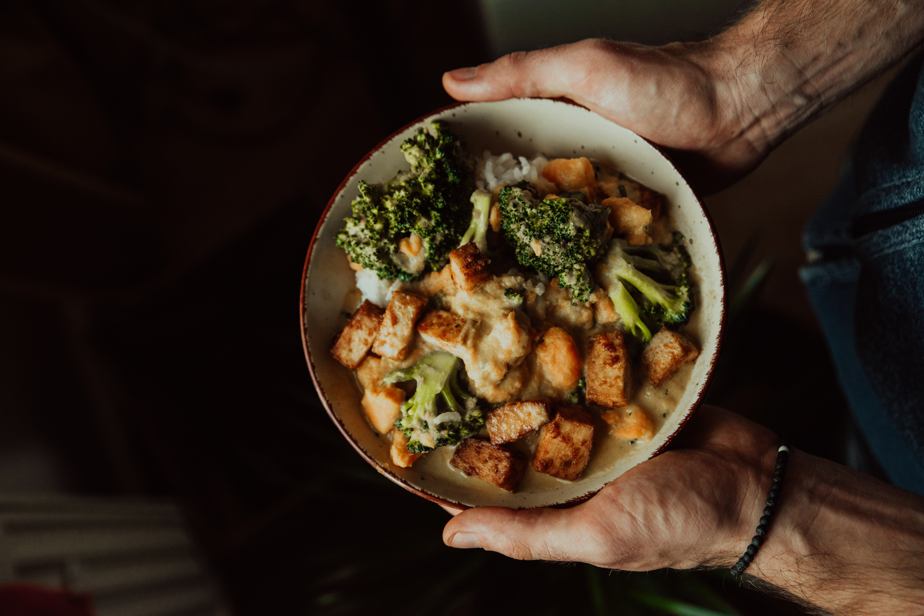
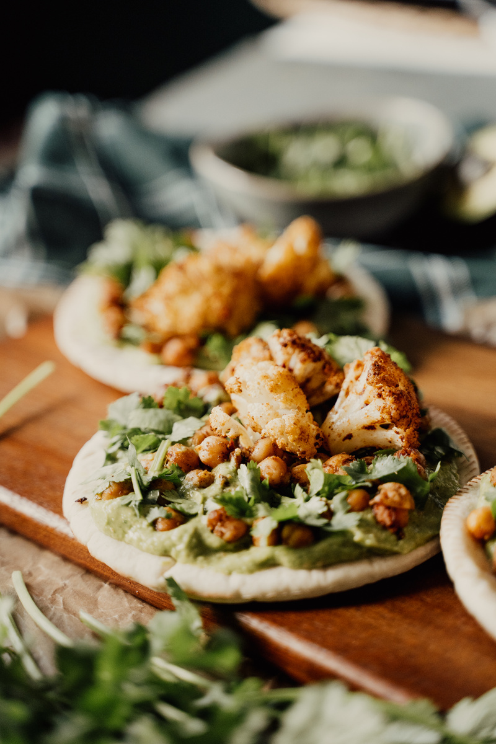

Abstract
•ONLINE FOOD DELIVERY SYSTEM is a website which is designed primarily for use in the food delivery industry.
•This system will allow hotels and restaurants to increase scope of their business by reducing the labour cost involved.
•This also enables contact less delivery for the consumers and saves time for them.

Slide 4
Technology used
•Spring boot
•Type Script
•Java Script
•My SQL
•Angular
•HTML
•CSS
•JPA
Postman

Slide 5
Tools used
•Server – Tomcat 9
•Database-MYSQL,MYSQL Connector
•Node js
•Angular
•Post Man
•JDK
•Eclipse or Spring Tool Suite

Slide 6
Angular overview
•Angular is a JavaScript Framework
•Angular is used to build client-side applications using HTML
•Angular bootstraps JavaScript with HTML tags
•Angular is used to make reach UI application.
•Angular enhances UI experience for User.
•Angular code is written in TypeScript language
• TypeScript is compiled into JavaScript
• JavaScript is used in HTML pages

Slide 7
SPRING OVERVEIW
•Spring makes it easy to create Java enterprise applications. It provides everything you need to embrace the Java language in an enterprise environment, with support for Groovy and Kotlin as alternative languages on the JVM, and with the flexibility to create many kinds of architectures depending on an application’s needs. As of Spring Framework 6.0, Spring requires Java 17+

Slide 8
Spring supports a wide range of application scenarios. In a large enterprise, applications often exist for a long time and have to run on a JDK and application server whose upgrade cycle is beyond developer control. Others may run as a single jar with the server embedded, possibly in a cloud environment. Yet others may be standalone applications (such as batch or integration workloads) that do not need a server.
Spring is open source. It has a large and active community that provides continuous feedback based on a diverse range of real-world use cases. This has helped Spring to successfully evolve over a very long time.

Slide 9
My sql over view
MySQL is a relational database management system (RDBMS) developed by Oracle that is based on structured query language (SQL).
A database is a structured collection of data. It may be anything from a simple shopping list to a picture gallery or a place to hold the vast amounts of information in a corporate network.

Slide 10
In particular, a relational database is a digital store collecting data and organizing it according to the relational model. In this model, tables consist of rows and columns, and relationships between data elements all follow a strict logical structure. An RDBMS is simply the set of software tools used to actually implement, manage, and query such a database.

Slide 11
Postman overview
•Postman is an API platform for building and using APIs. Postman simplifies each step of the API lifecycle and streamlines collaboration so you can create better APIs—faster.
•Postman's features simplify each step of building an API and streamline collaboration to help create better APIs—faster. More than 30 million developers and 500,000 organizations across the globe use Postman today.

Slide 12
Introduction
•Home Chef Oasis is an online food delivery web application for ordering food items of different cuisines from a restaurant.
•Home Chef Oasis is a restaurant chain that delivers food items of different cuisines at affordable prices.

Slide 13
Modules
Registration Page.
Login Page.
User Login/Logout
Admin Login.
Dashboard.
Search Products.
Add Cart/View Cart.
View Previous Active Orders.
Payment Gateway Page.
Order Summary Confirmation Page

Slide 14

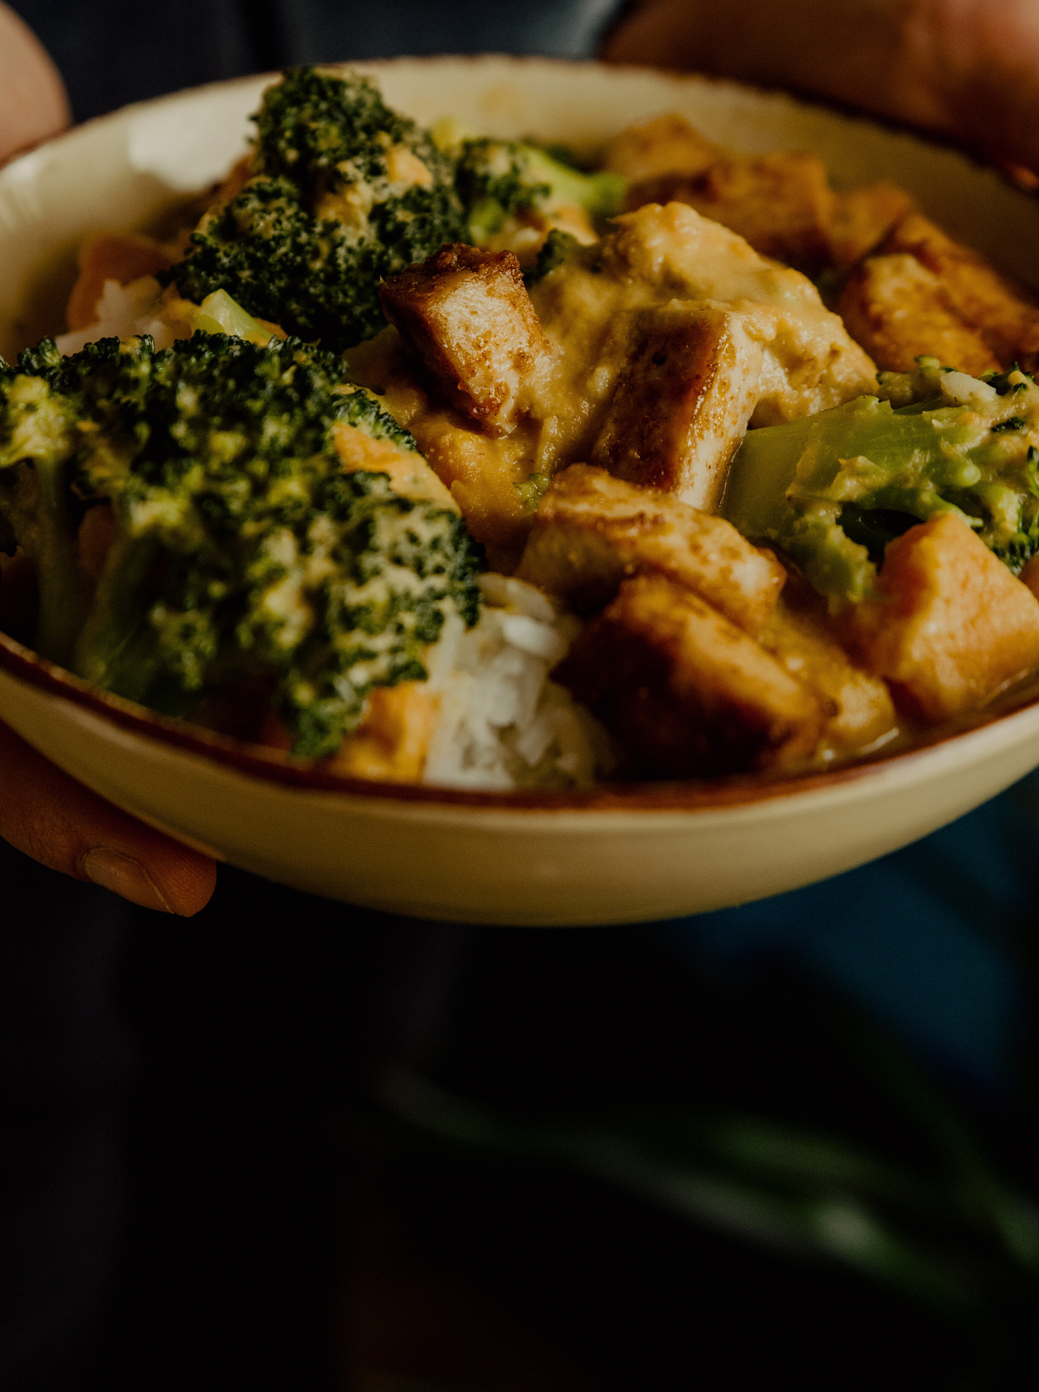
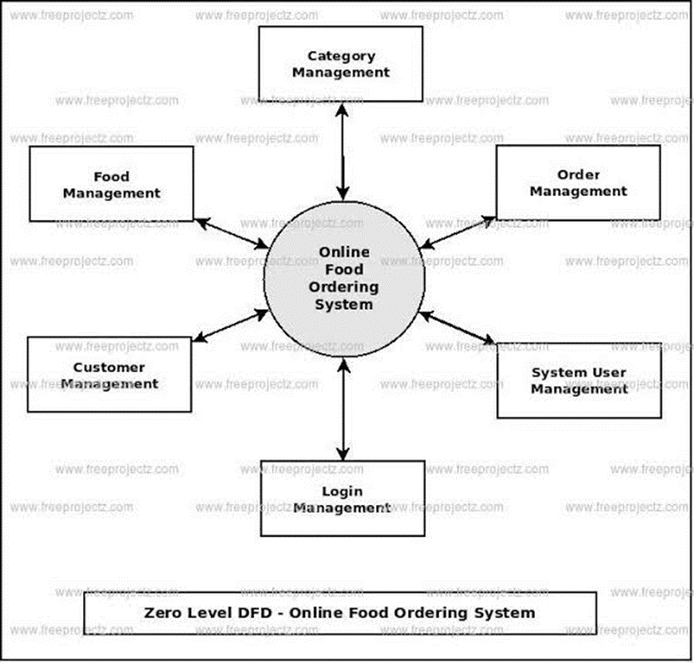

Project flow

Slide 15

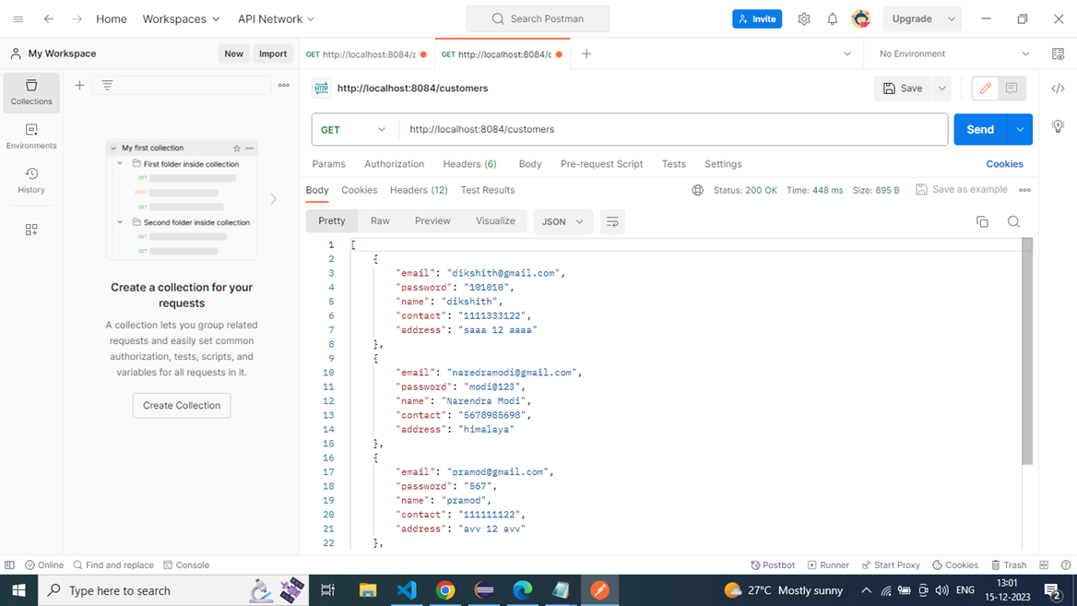
Functional Post man Testing
GET Customers

Slide 16
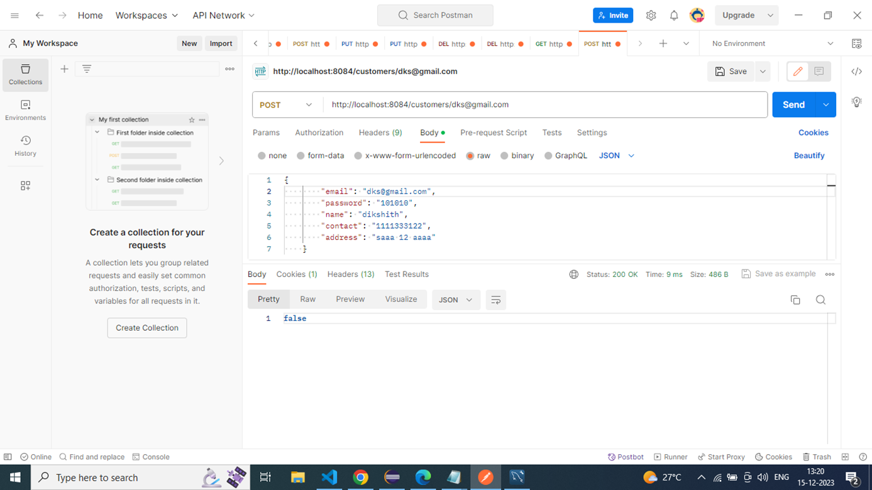
•Post Costumers through E-mail

Slide 17
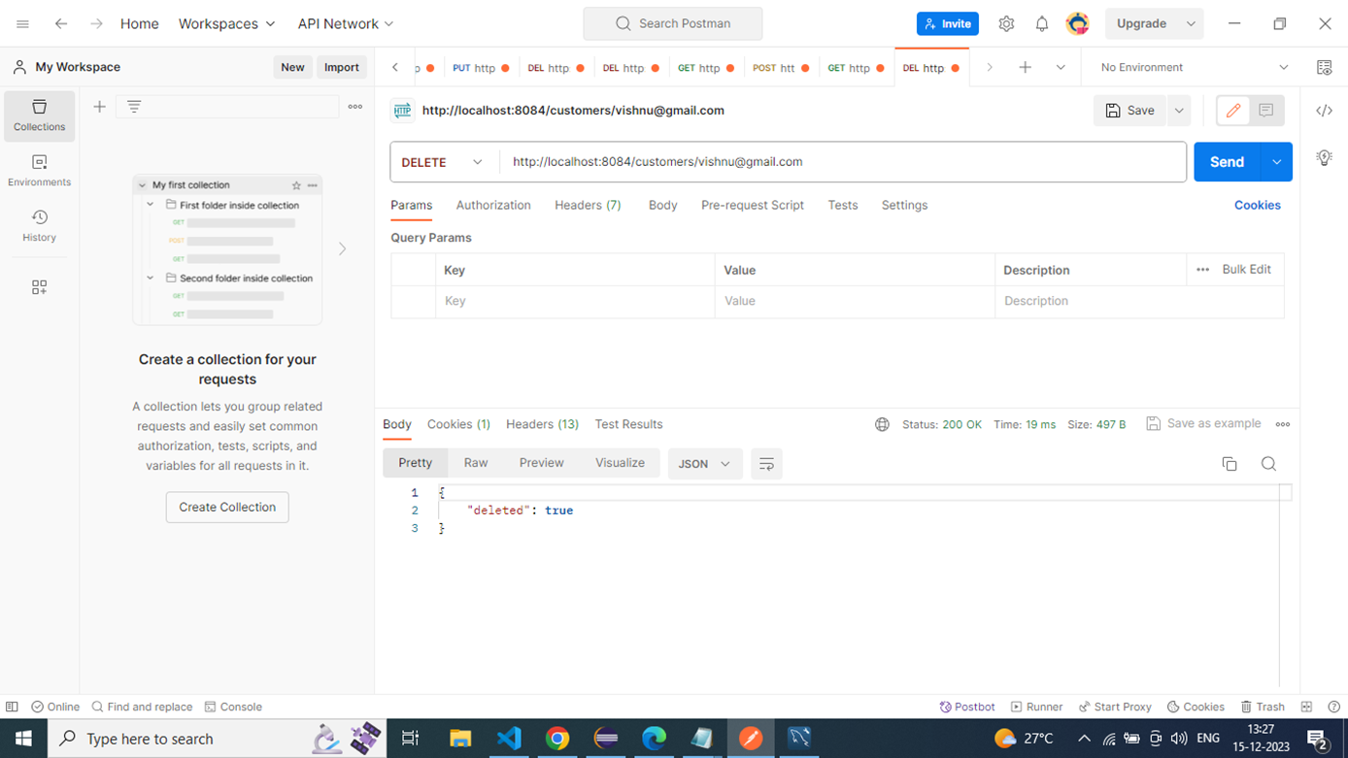
•Delete Customer

Slide 18
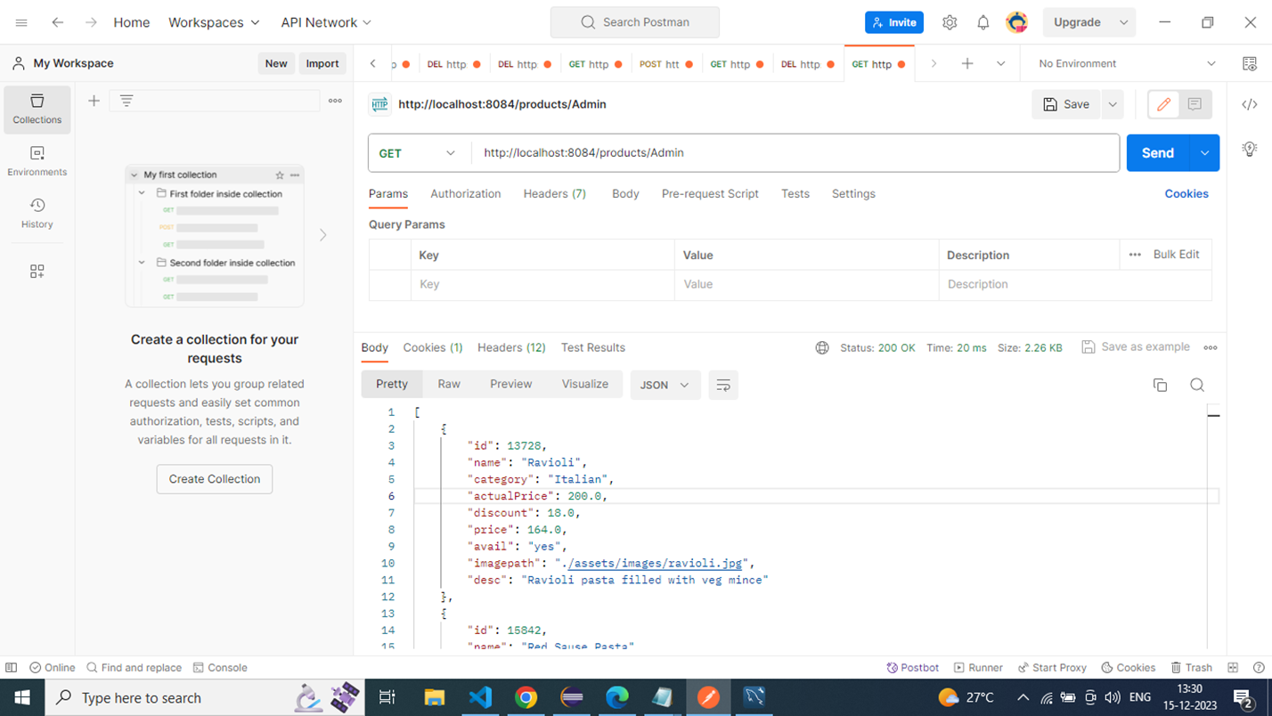
•Get Products for Admin

Slide 19

•Get Products For Customer

Slide 20

•Get Products By id

Slide 21

•Get products through search

Slide 22
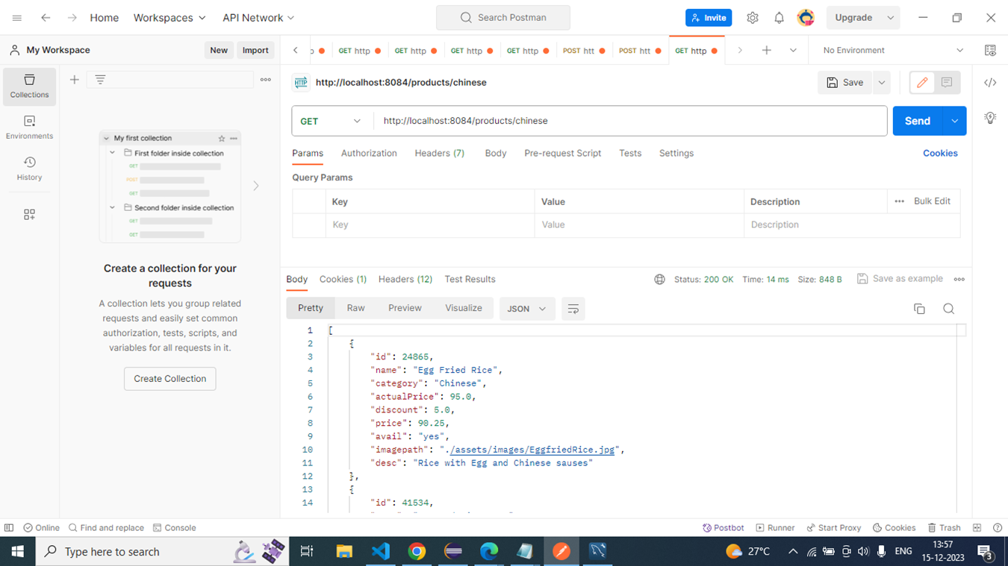
•Get products through search

Slide 23

•Get products through search

Slide 24

•Get products through search

Slide 25
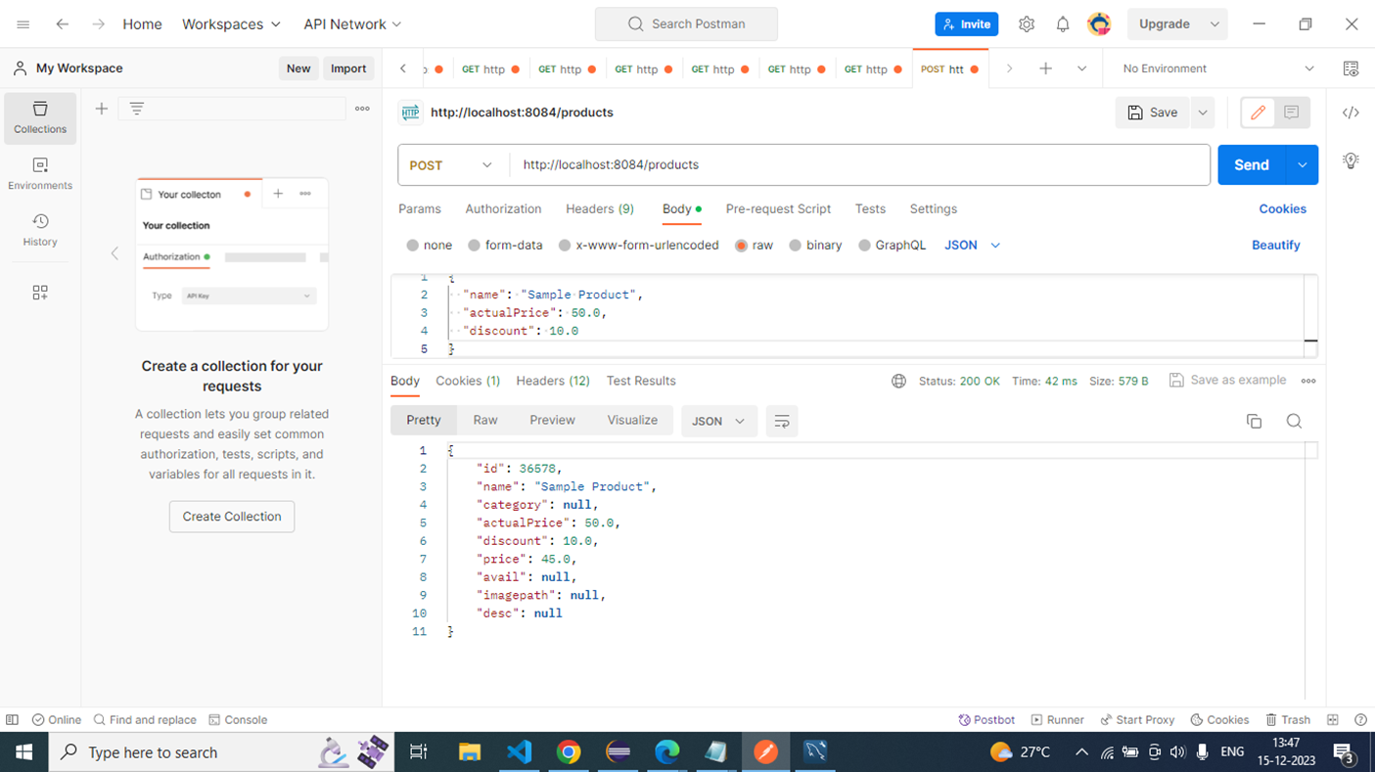
Post products

Slide 26

Get purchase by email

Slide 27

Get purchase

Slide 28
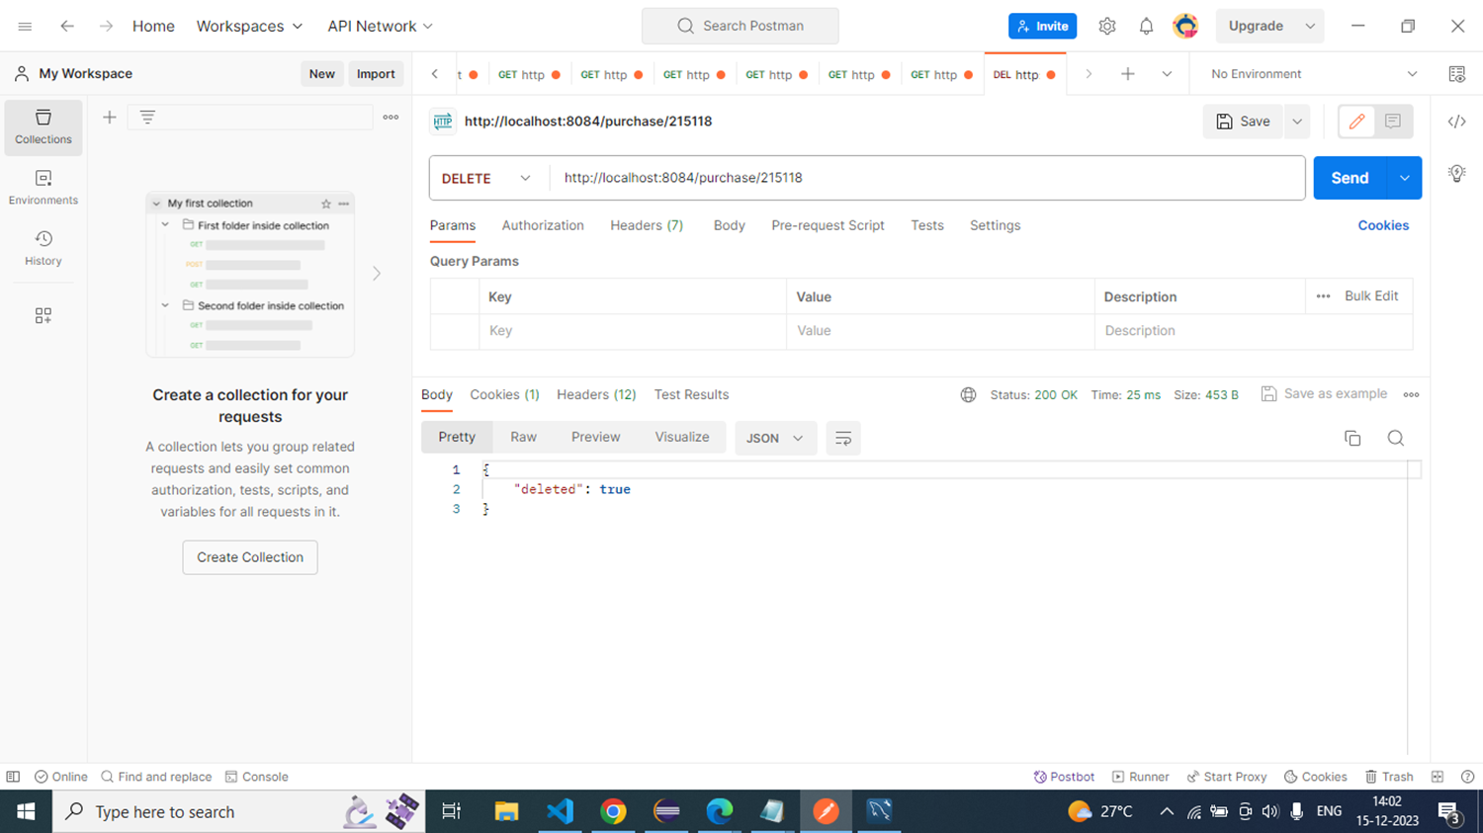
delete purchase by ID

Slide 29

Get purchase by search

Slide 30
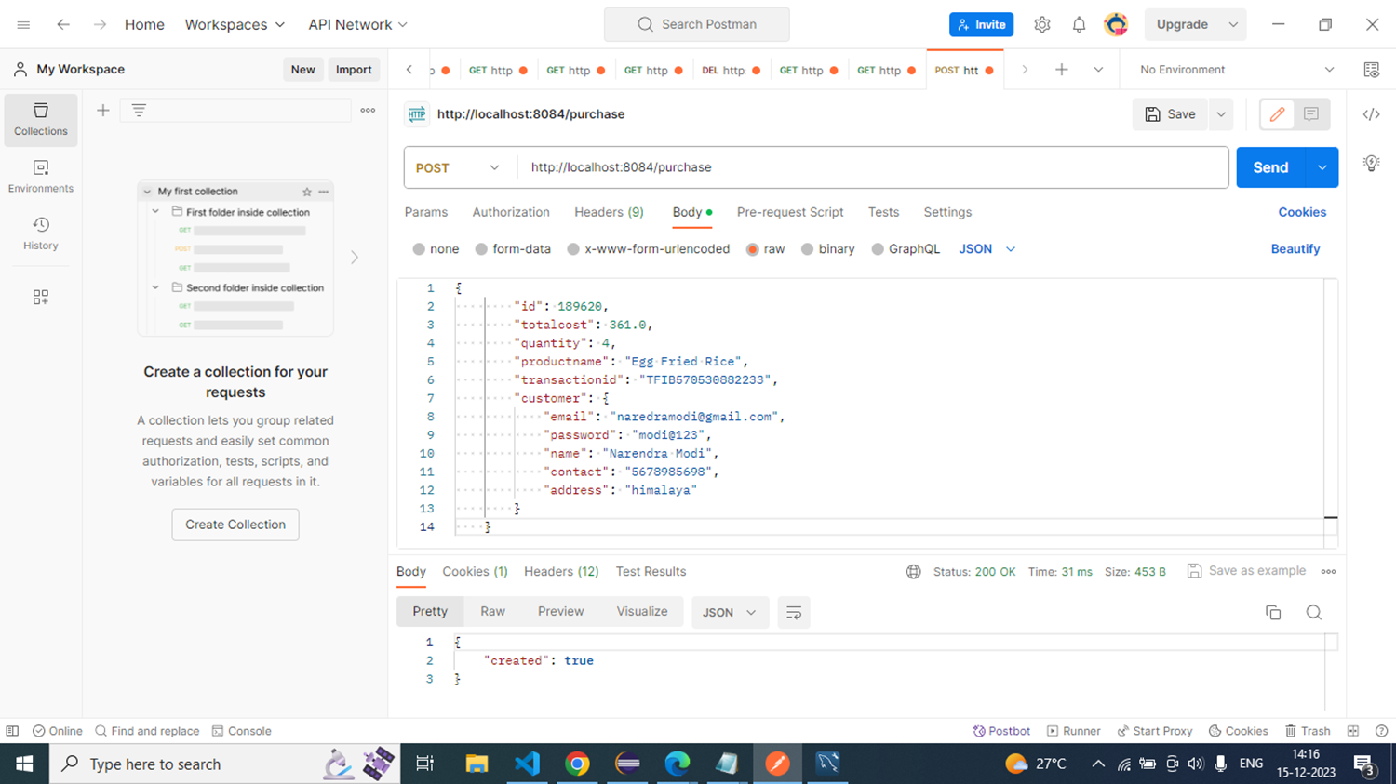
Post purchase

Slide 31

Post purchase

Slide 32
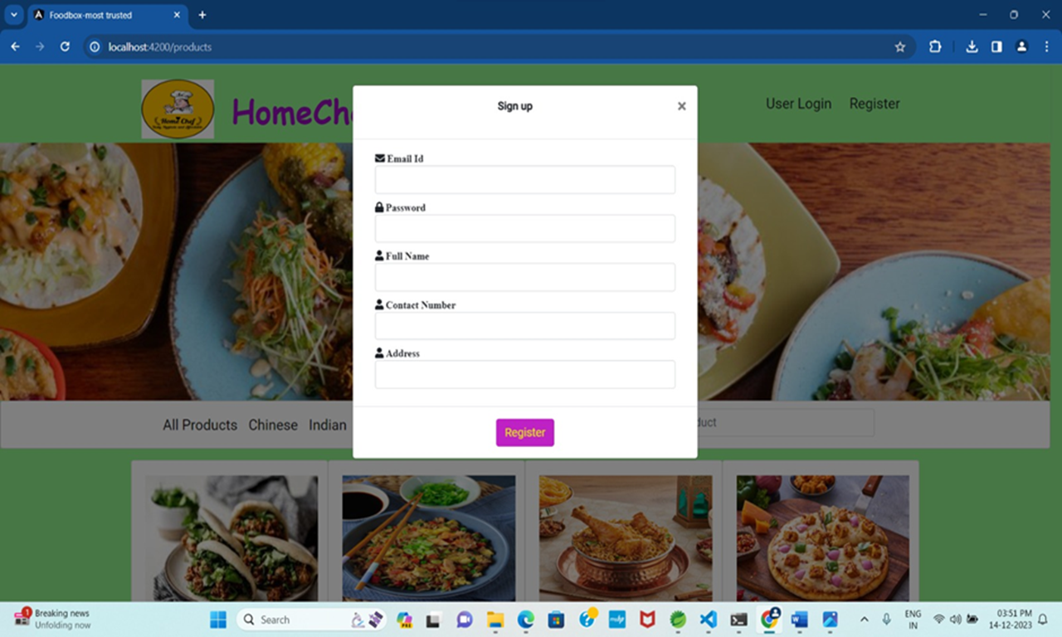
REGISTRATION PAGE

Slide 33
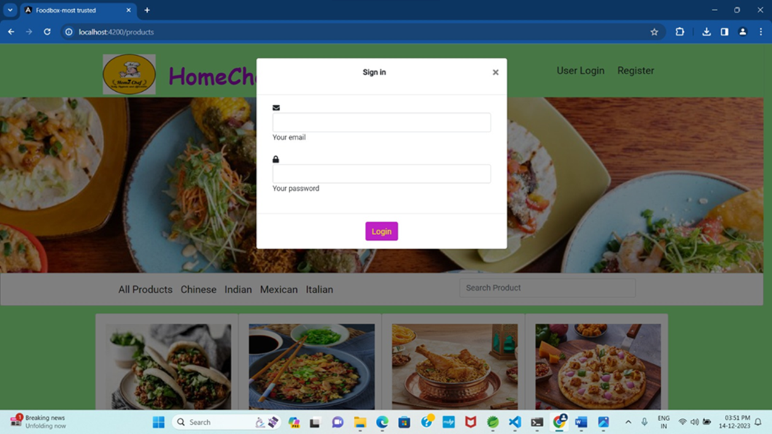
LOGIN PAGE

Slide 34
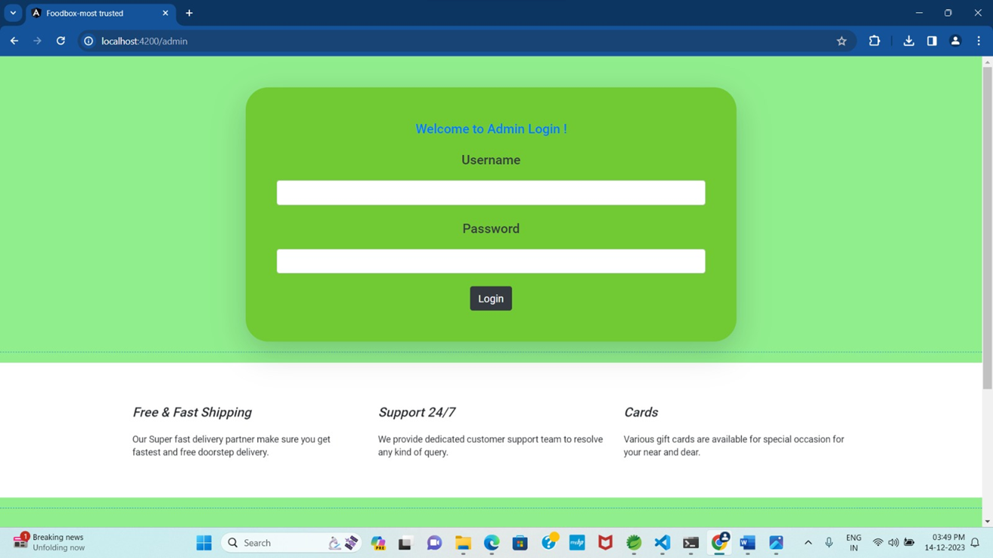
ADMIN LOGIN PAGE

Slide 35
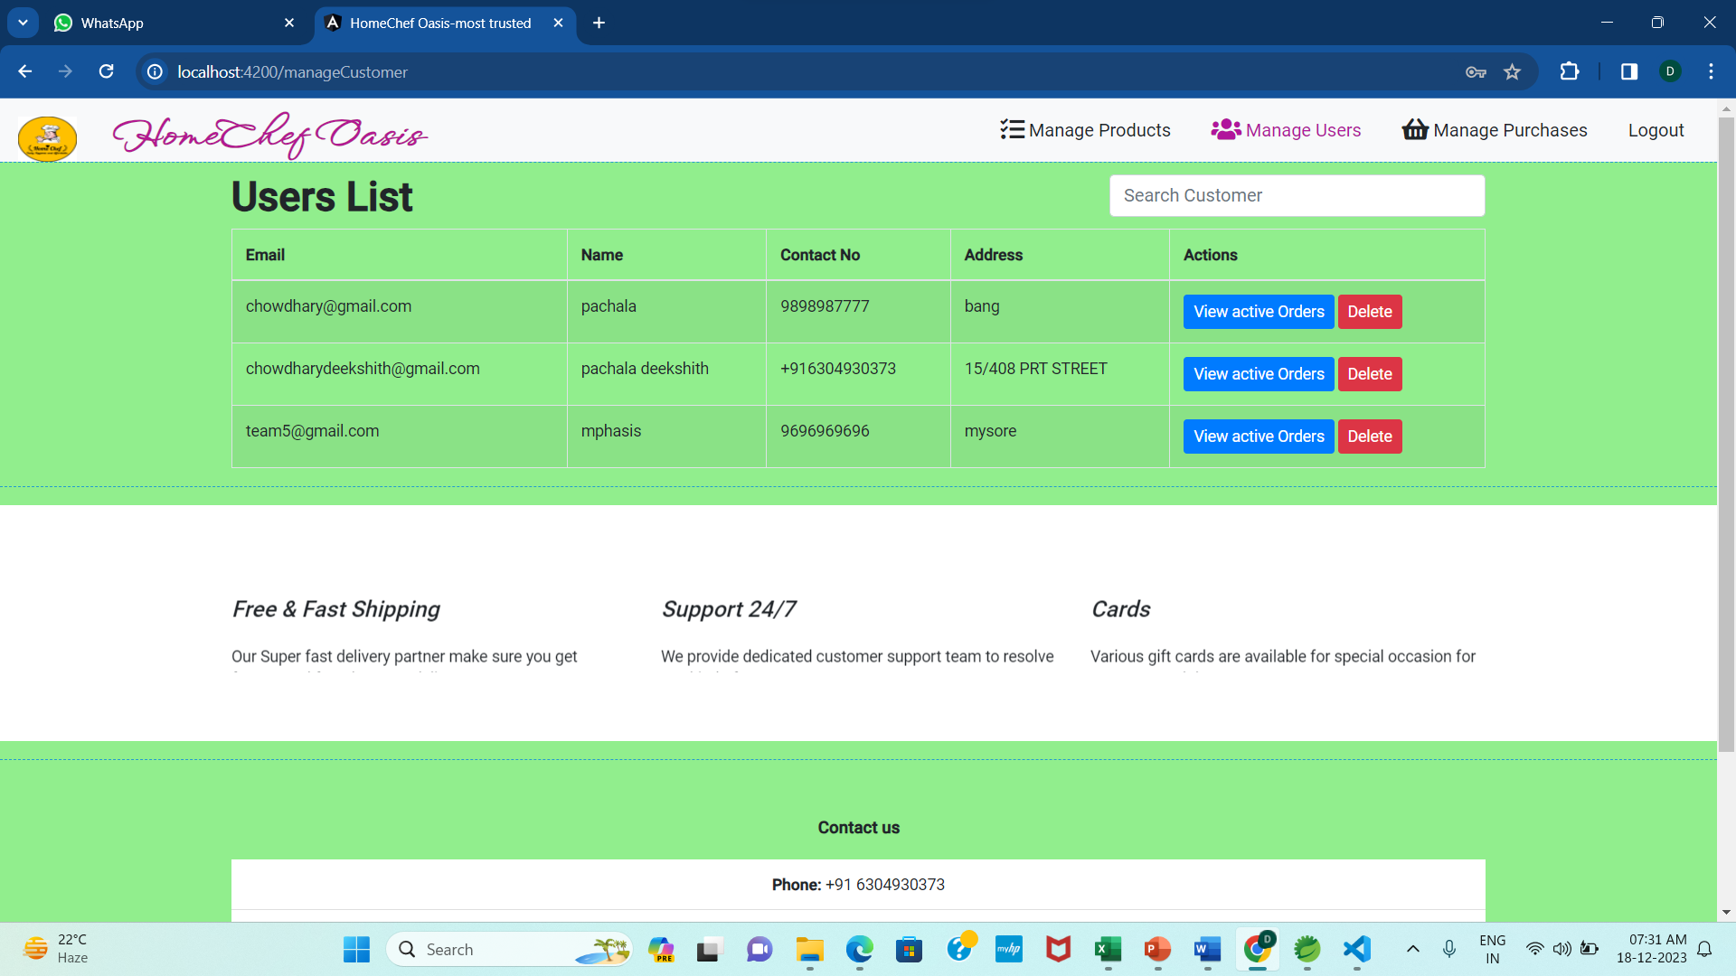
ADMIN PAGE AFTER LOGIN

Slide 36
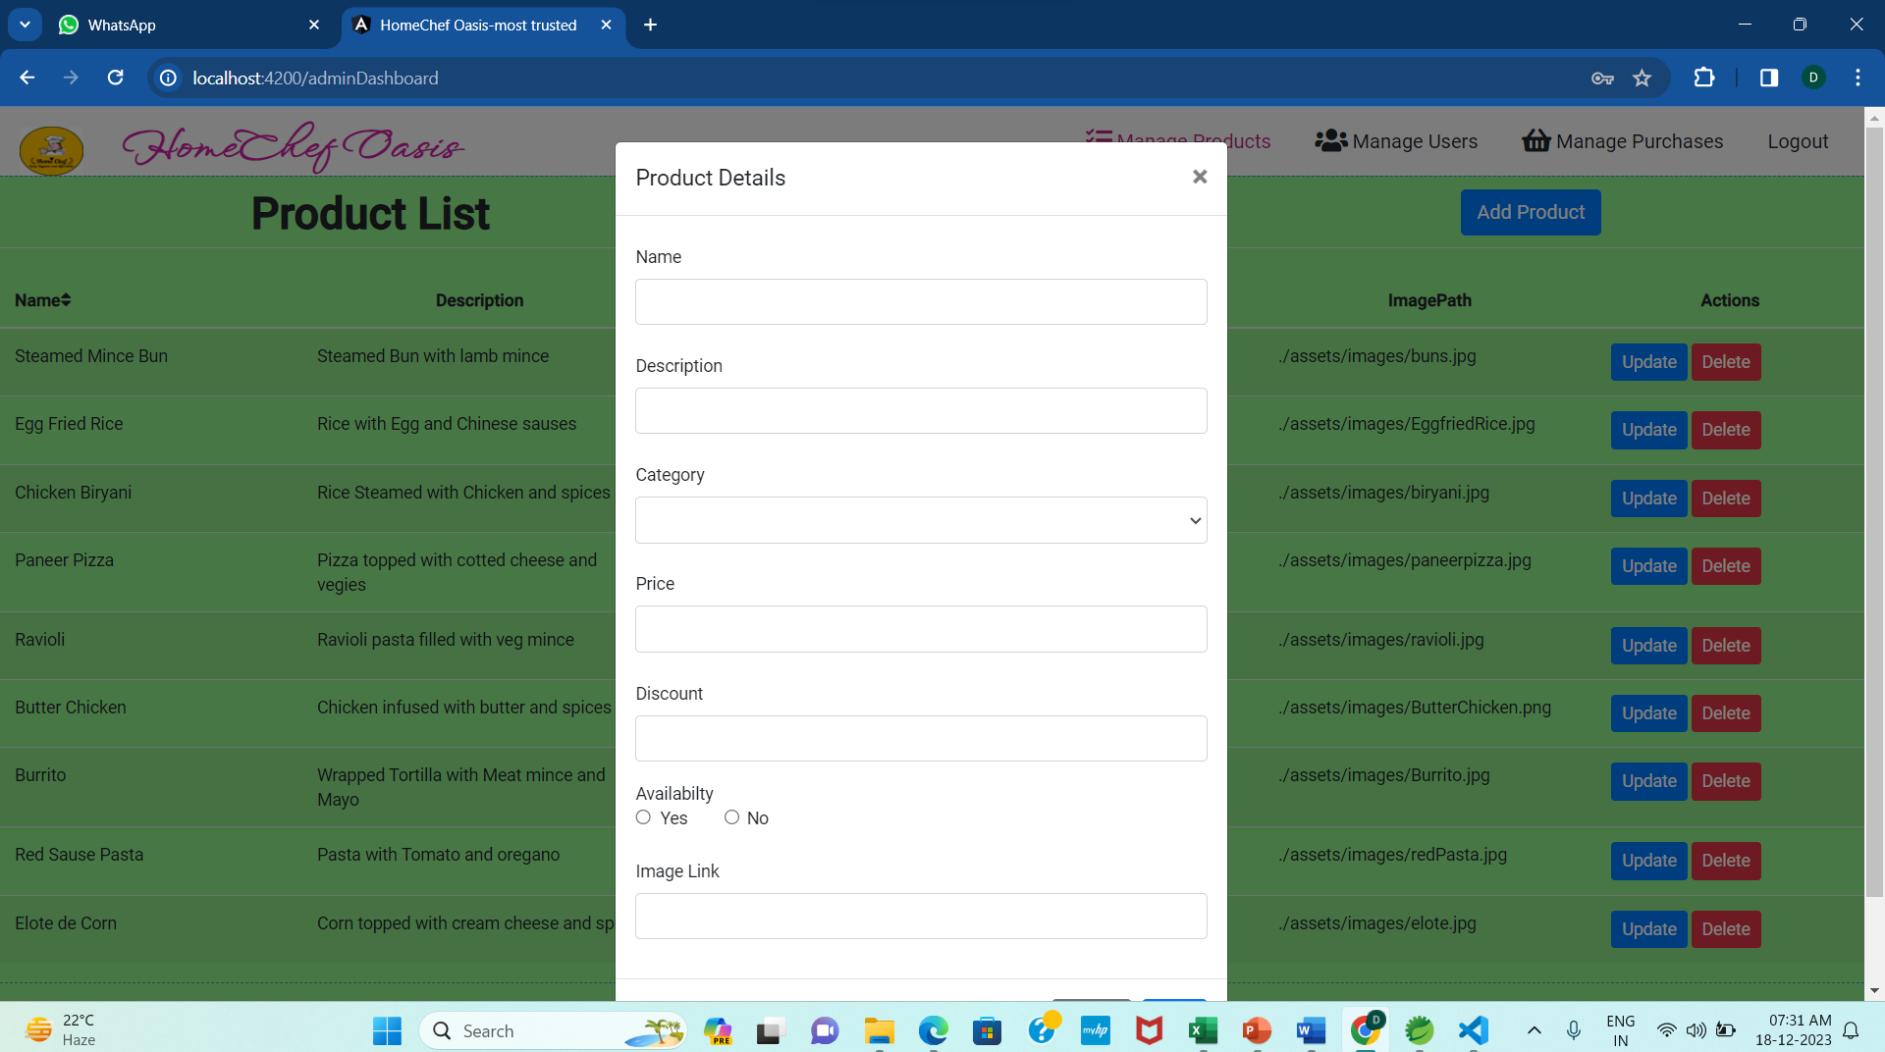
ADDING PRODUCTS BY ADMIN

Slide 37
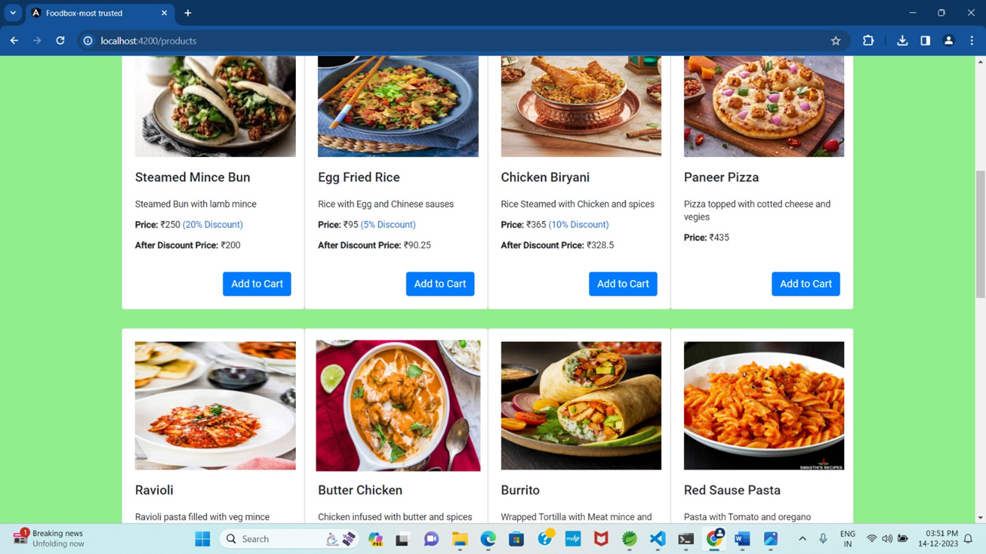
RESTAURANT PAGE

Slide 38
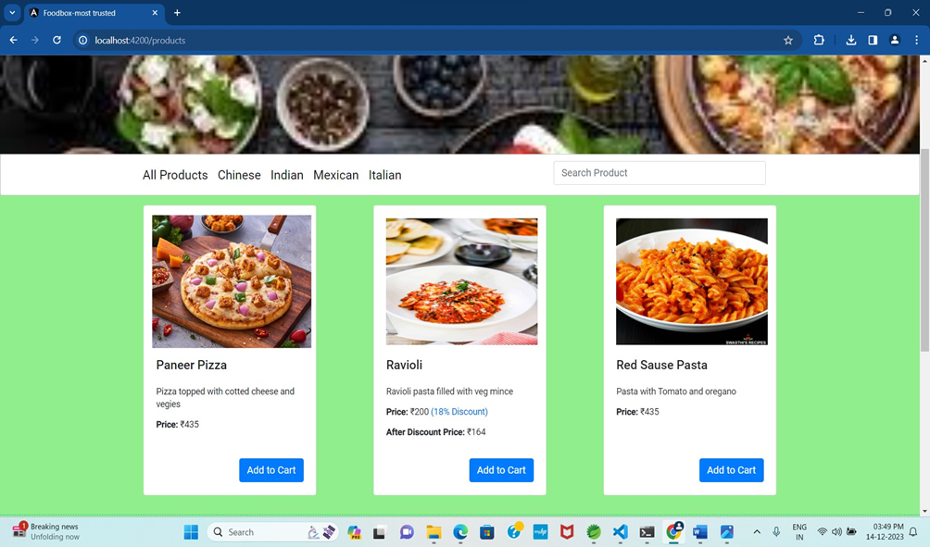
HOME PAGE
All products

Slide 39
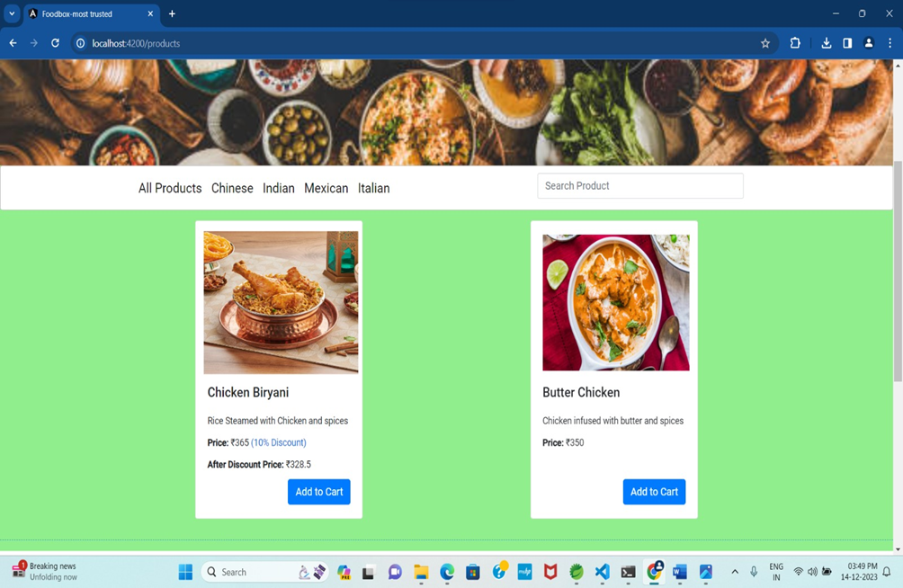
Indian products

Slide 40
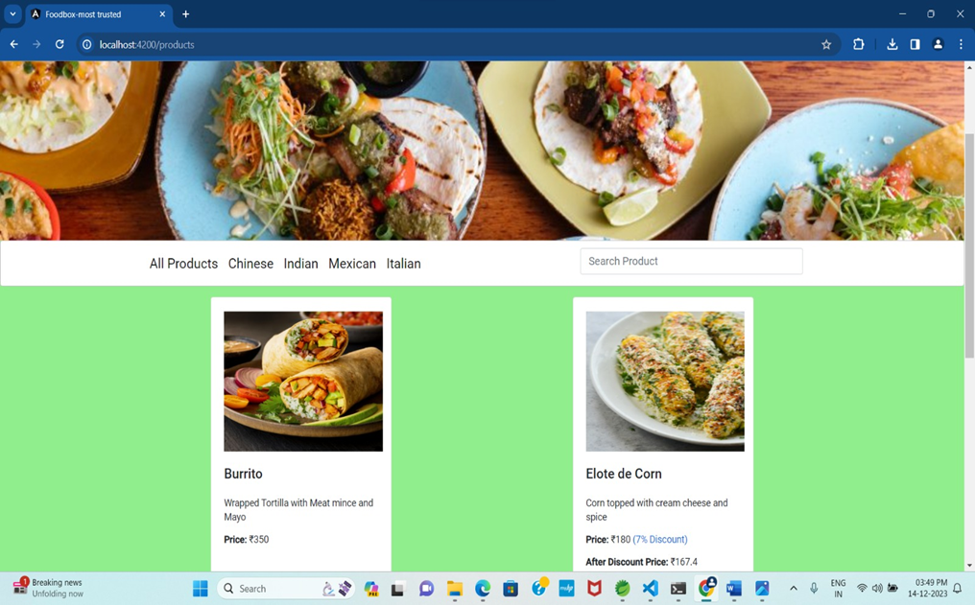
Italian products

Slide 41

Mexican products

Slide 42
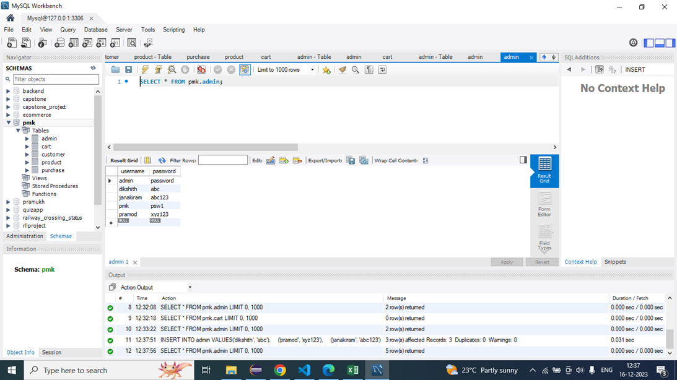
DATA BASE
Admin

Slide 43
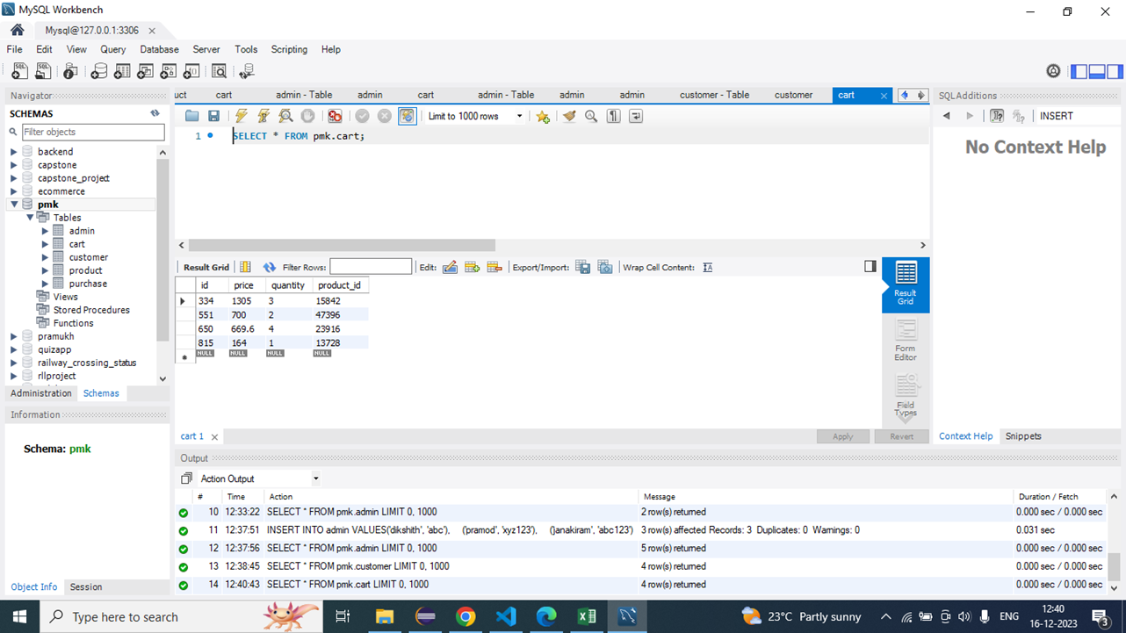
CART

Slide 44
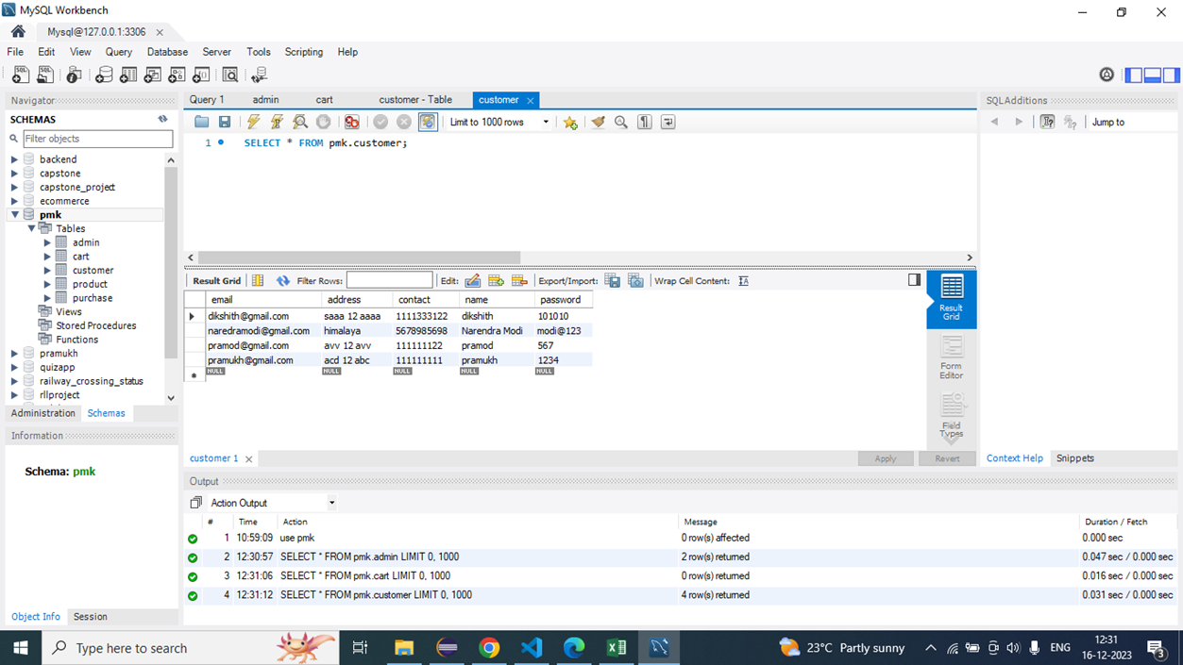
CUSTOMERS

Slide 45
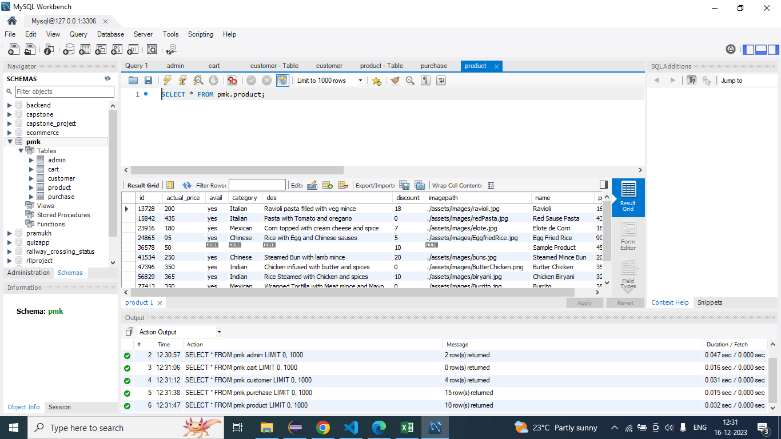
PRODUCTS

Slide 46
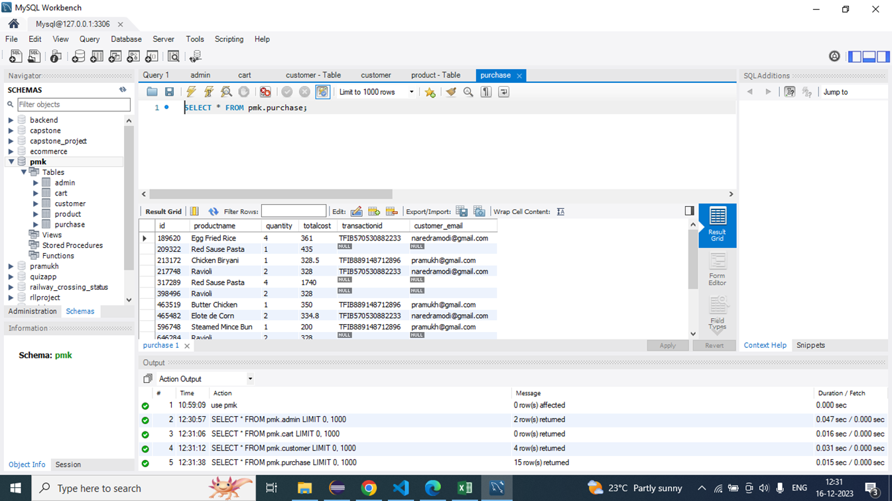
PURCHASE

Slide 47
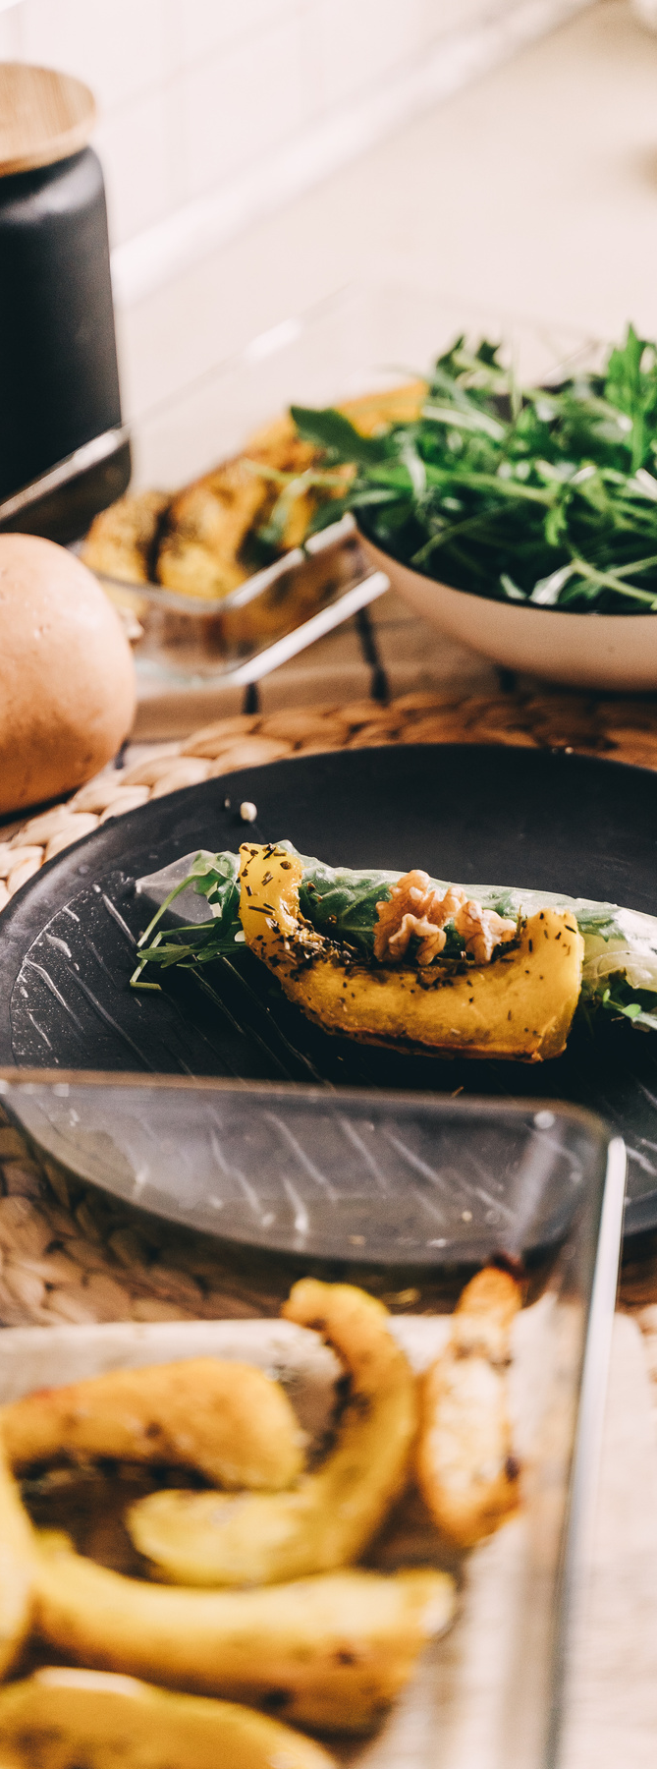
CONCLUSION
An online food ordering system is developed where the customers can make an order for the food and avoid the hassles of waiting for the order to be taken by the waiter.
Using the application, the end users register online, read the E-menu card and select the food from the e-menu card to order food online. Once the customer selects the required food item the chef will be able to see the results on the screen and start processing the food.
To provide a bug-free Online Food Delivery system to Users as well as Admin.
The main objective is here to provide a nice and secure platform for Ordering Food. To maintain the records of Product, Category available into the system.

Slide 48
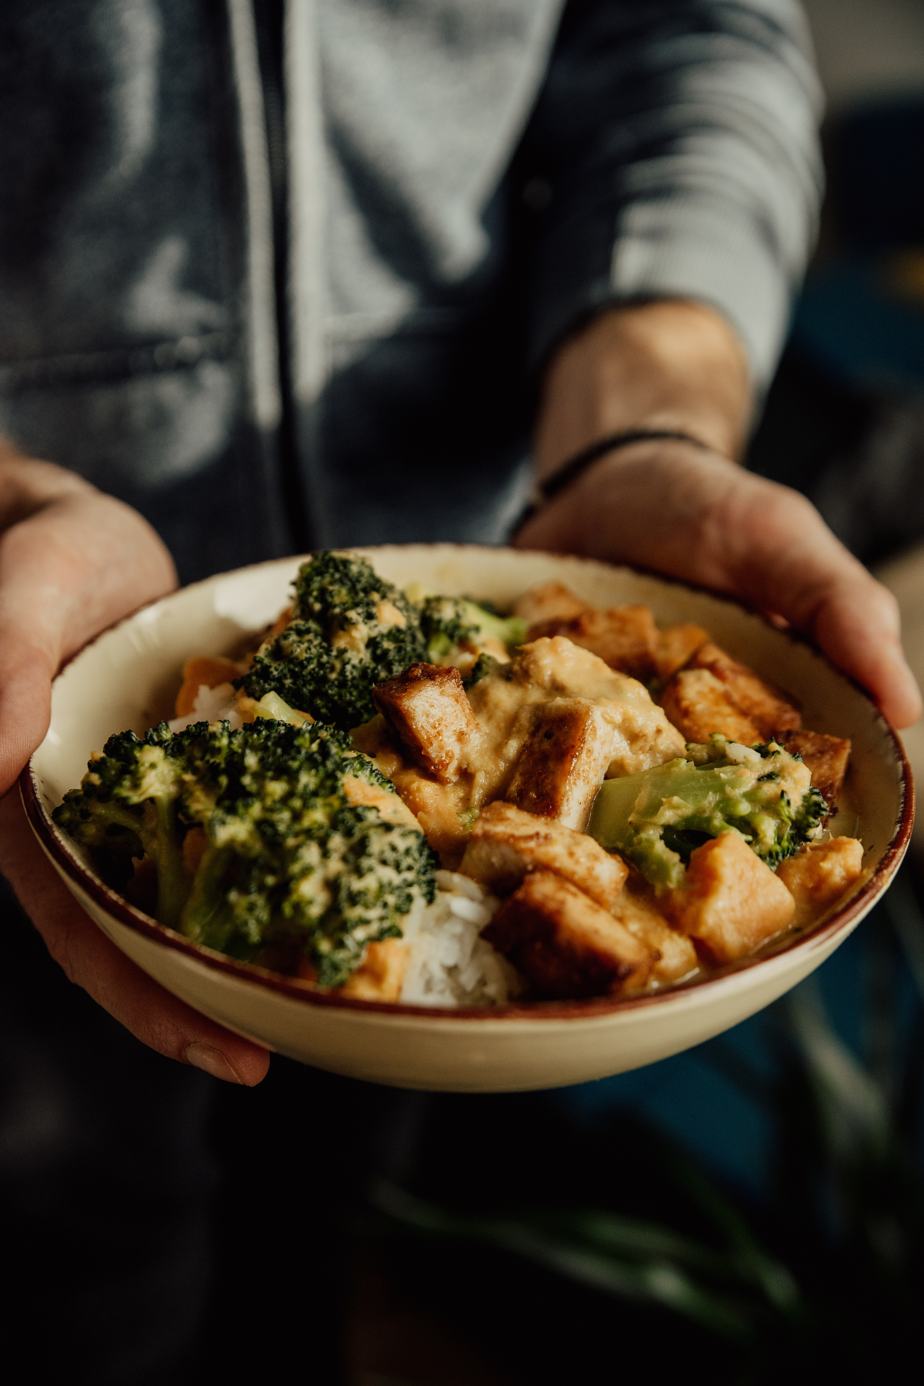

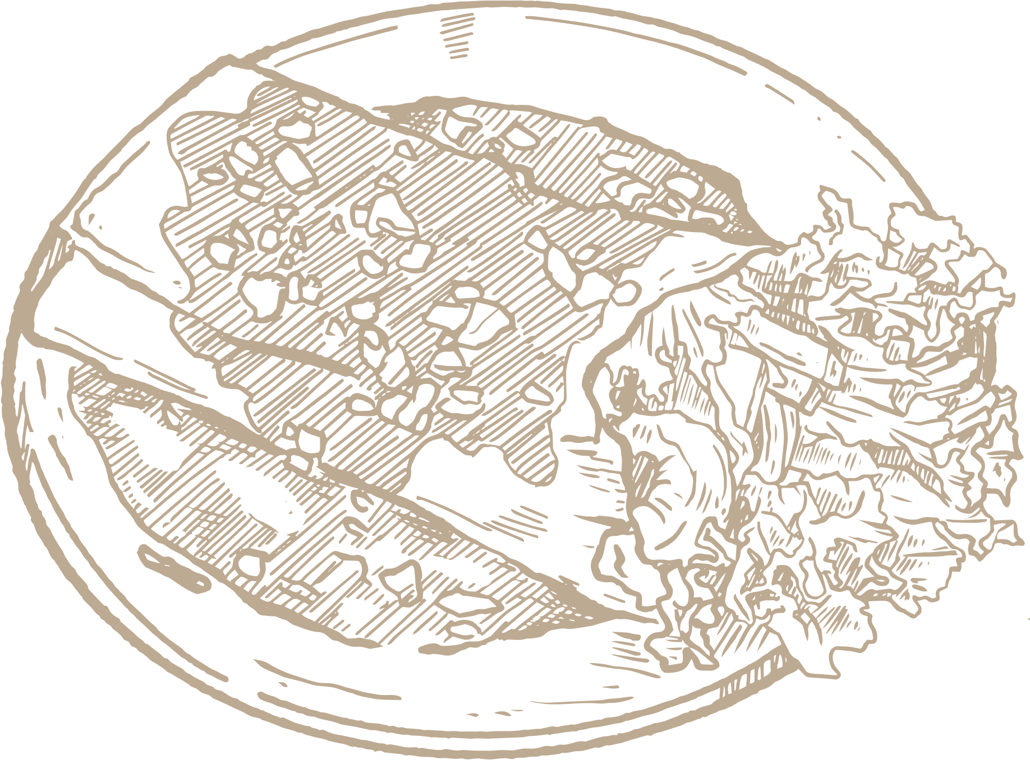
Thank You

